Slide 1
Survival Analysis and Statistical Reliability Theory
Master's Program: Computational and Statistical Analytics in Data Science.
Course: Survival Analysis and Statistical Reliability Theory.
Academic Year: 2023-24
Spyridoula Ira
Karniak

Slide 2
Introduction
The flchain dataset comes from a scientific study focusing on the relationship between biological parameters, specifically the serum free light chains (FLC) and mortality. It includes information such as age, sex, FLC levels, and death status from 7874 observations.
Dataset: “Flchain" from the R package Survival

Slide 3
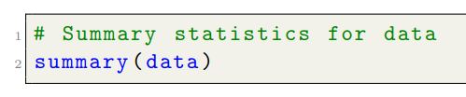
Description of Dataset Variables
Variable Analysis
Age (age): Ranges from 50 to 101, with an average of about 64.
Sex (sex): There are 4350 women and 3524 men in the dataset.
Year of blood sample collection (sample.yr): Data ranges from 1995 to 2003, with the median and mean years being 1996 and 1997, respectively.
Kappa level (kappa): Ranges from 0.010 to 20.500, with an average of about 1.431.
Lambda level (lambda): Ranges from 0.040 to 26.600, with an average of about 1.703.
FLC Group (flc.grp): Ranges from 1 to 10.
Creatinine level (creatinine): Ranges from 0.400 to 10.800, with an average of about 1.093.
MGUS Diagnosis (mgus): There are 7759 observations with a value of 0 and 115 with a value of 1.
Time to death (futime): Ranges from 0 to 5215, with an average of about 3661.
Death status (death): Includes binary values, 0 or 1, indicating whether the person has died or not. About 27.55% of individuals have died.
Cause of Death (chapter): Includes categorical data explaining the main causes of death.

Slide 4
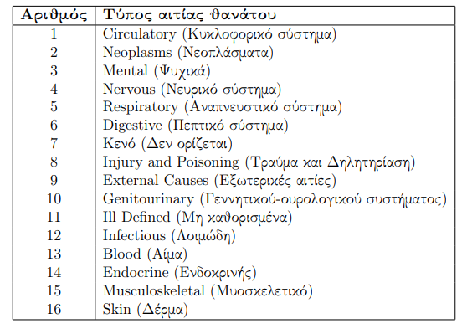

Description of Dataset Variables

Slide 5
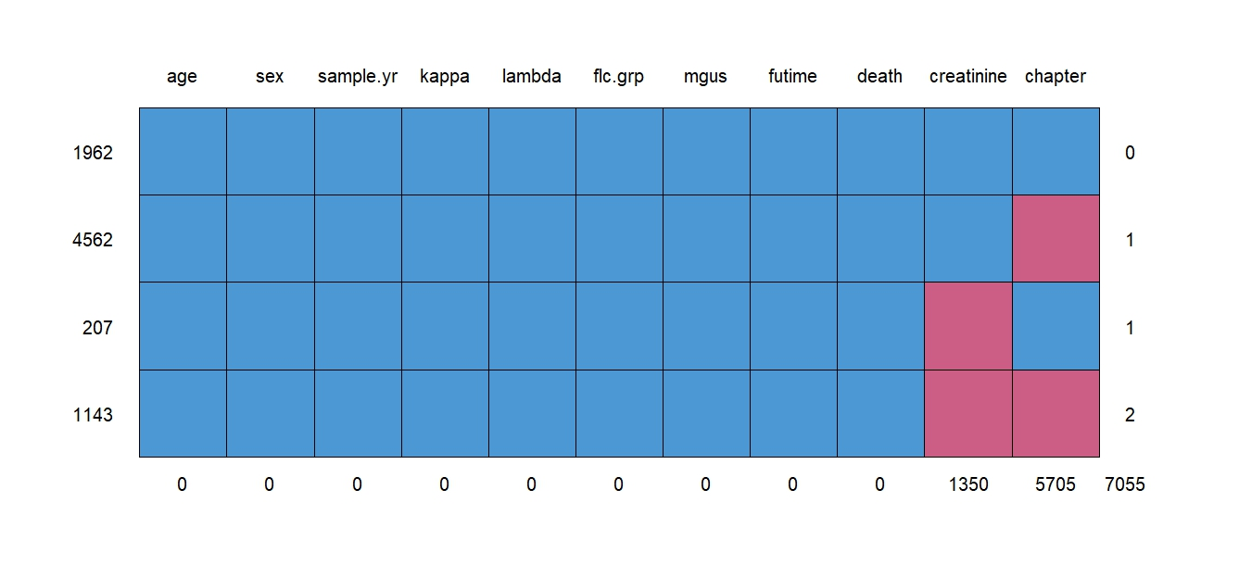
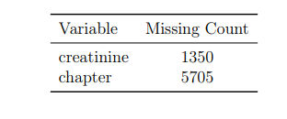
Missing Values

Slide 6
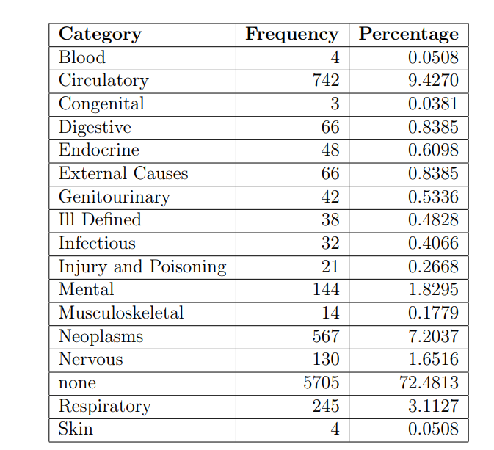
Handling Methods
There are 5705 missing values in the "Cause of Death" variable.
The value of "Cause of Death" depends on the "Death Status" variable.
"Cause of Death" is only available when "Death Status" is 1 (non-survival).
Missing values in observations with "Death Status" equal to 0 are replaced with "none".
Missing values in observations with "Death Status" equal to 1 are replaced with "Unknown".
For the missing values in the "Creatinine Level" variable, the MICE (Multiple Imputation by Chained Equations) method will be used.

Slide 7
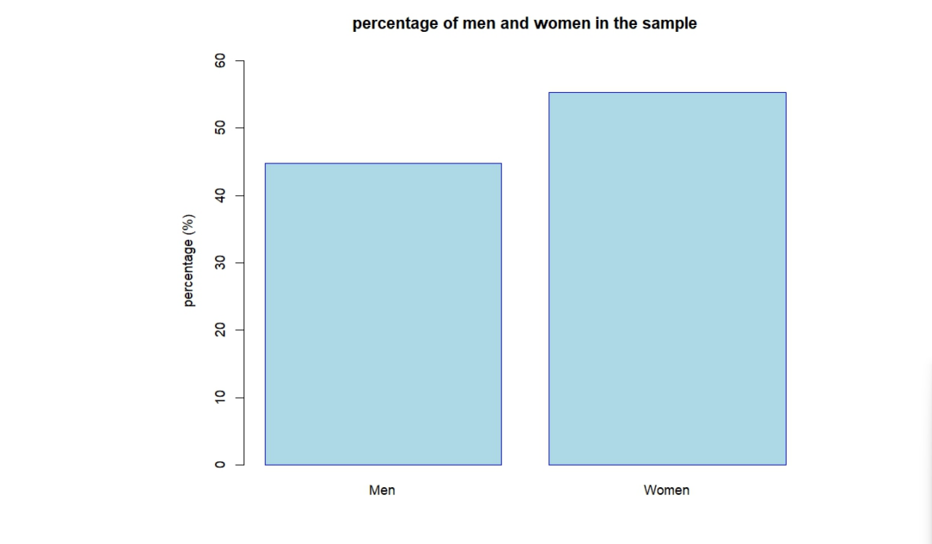
Gender Proportion
The proportion of women in the sample is greater than that of men. Specifically, the exact percentages show that the proportion of men in the sample is 45% and that of women is 55%.

Slide 8
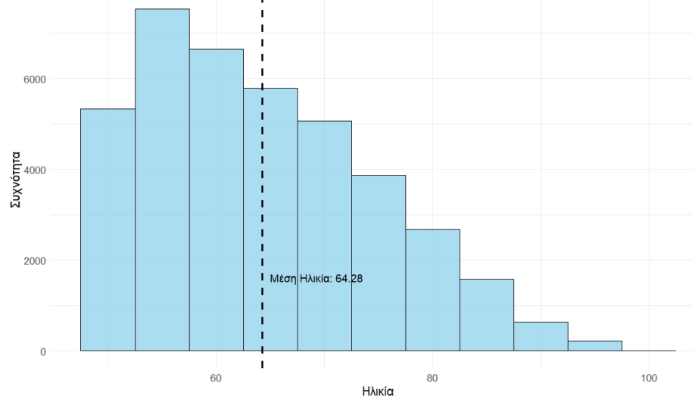
Age Distribution in the Sample

Slide 9
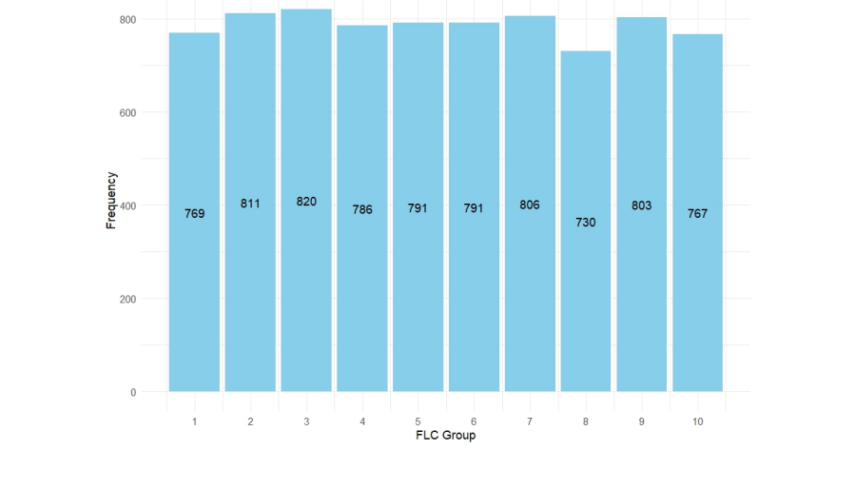
Frequency of Each FLC Group

Slide 10
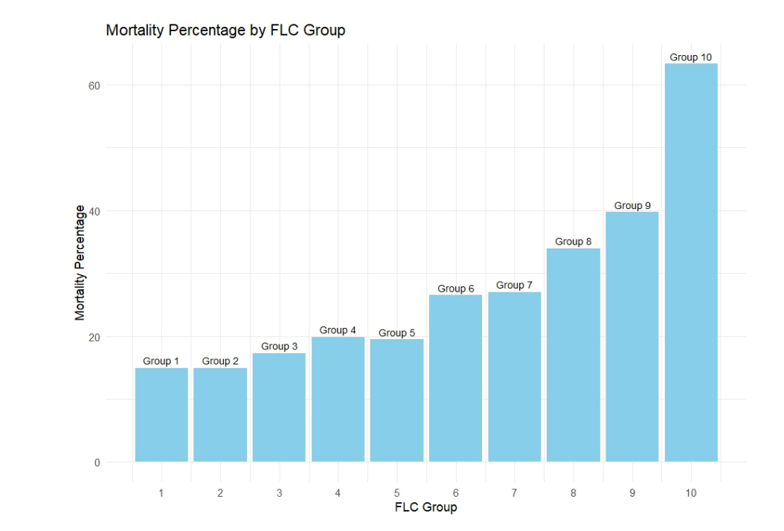
Mortality Rate for Each FLC Group
(1-10)

Slide 11
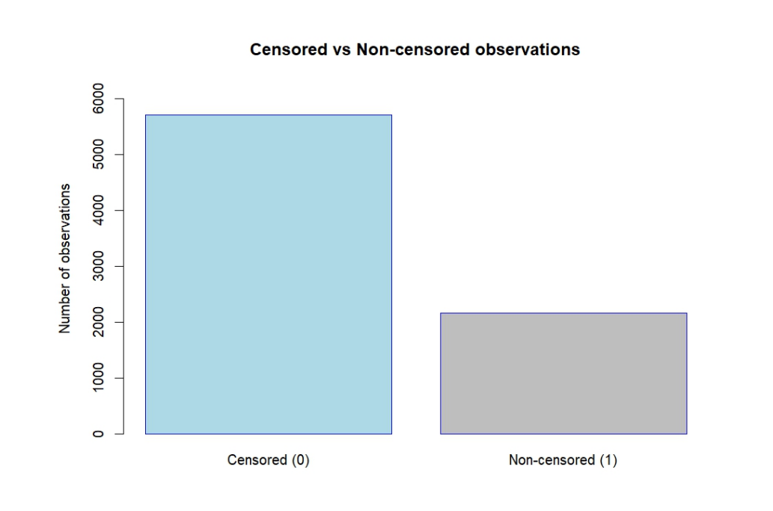
Censored Observations
It is observed that there is a large number of censored observations, 5705, representing 72.48% of the total dataset.

Slide 12
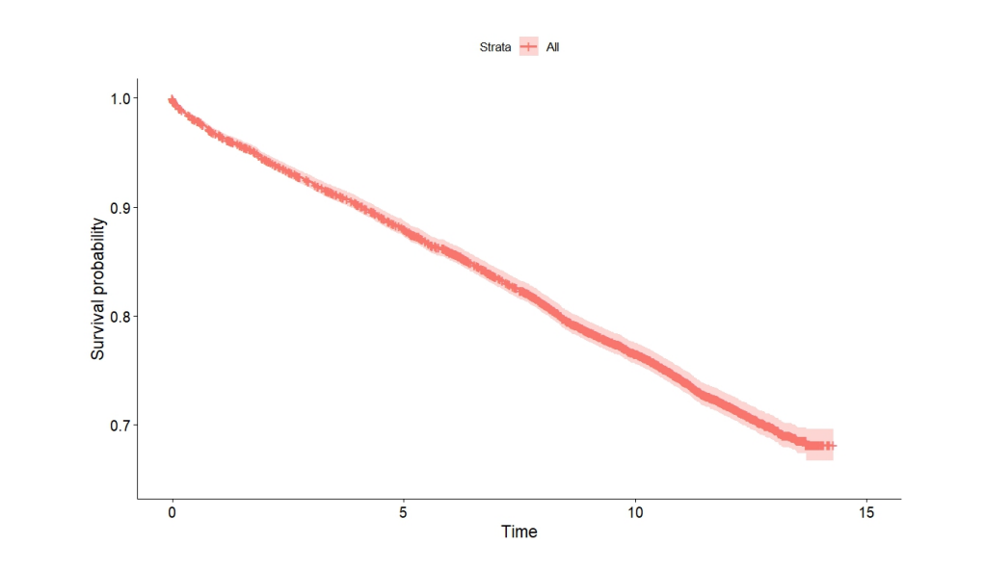
Kaplan-Meier Estimator
Time and Survival Axes: The horizontal axis represents time (in years), while the vertical axis represents the estimated survival probability at each time point.
Survival Curve: The line formed by the points on the graph represents the estimated survival curve of the data. It starts at 1 at time 0, where all individuals are alive, and decreases over time.
Confidence Interval: The graph also includes a range (confidence interval), which provides an estimate of the degree of certainty for each survival point. This helps in understanding the uncertainty associated with survival estimates.
The most significant observation is that there is a high censoring rate, confirming the previous results. Approximately 72% of individuals survive at the end of the study.

Slide 13
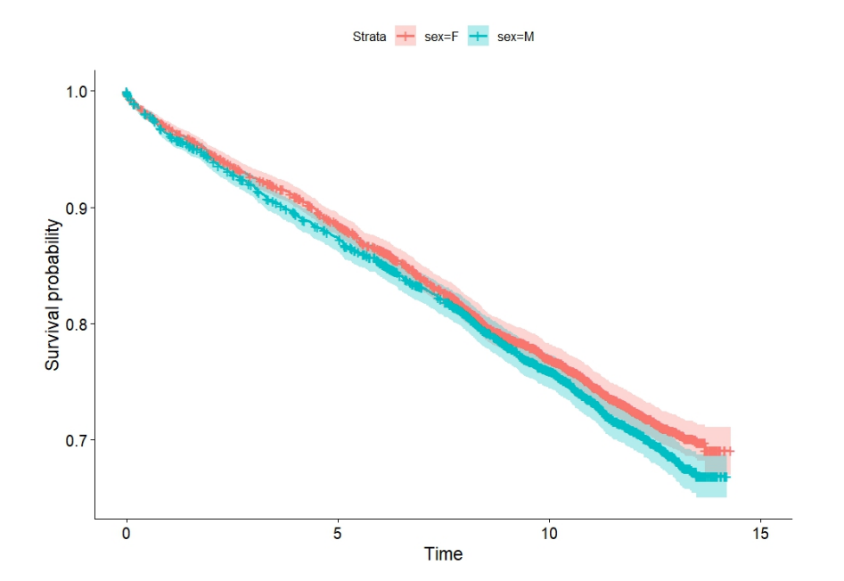
Kaplan-Meier Estimator for the Variable Sex
The graph shows the survival time of men and women, indicating a marginal difference in survival times, as suggested by the Log-Rank test. Initially, survival times do not differ, but over time, women have a slightly higher survival probability.

Slide 14
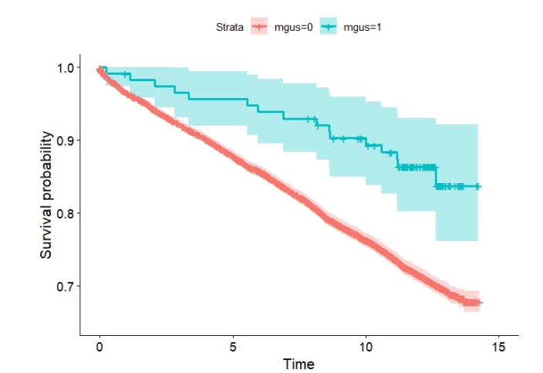
Kaplan-Meier Estimator for the Variable MGUS
Survival time differs significantly.

Slide 15
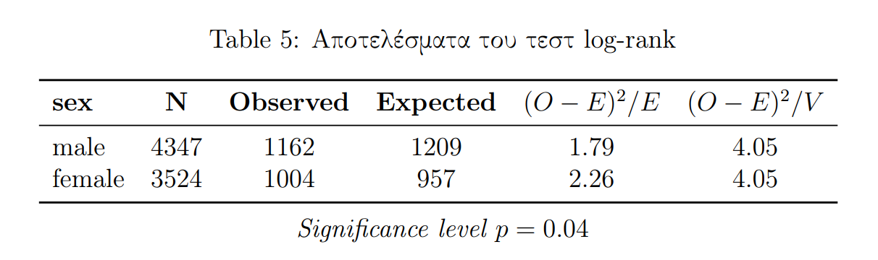
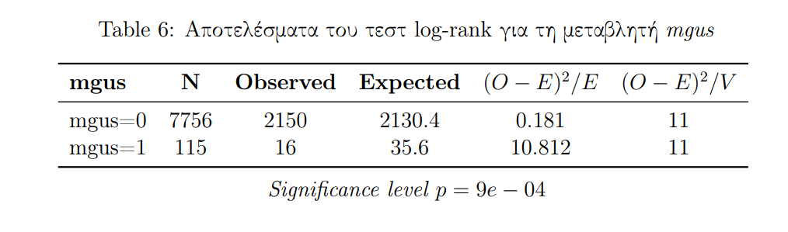
Log-Rank Test
Variable Sex
Variable Mgus
The result of the log-rank test shows a significant difference in survival times between the two gender groups in the sample data.
The log-rank test results for the categorical variable MGUS show a significant statistical difference in survival times between the two groups (MGUS=0 and MGUS=1).

Slide 16
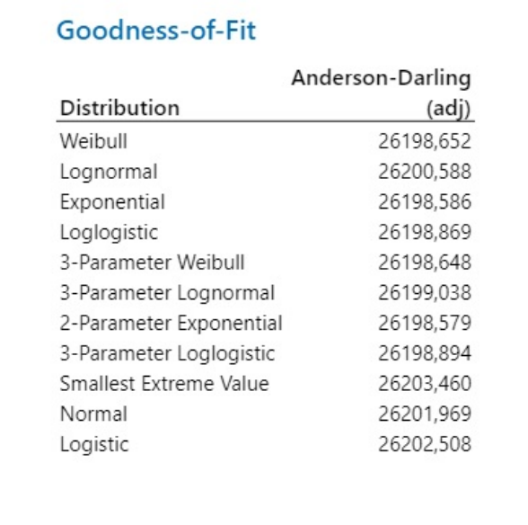
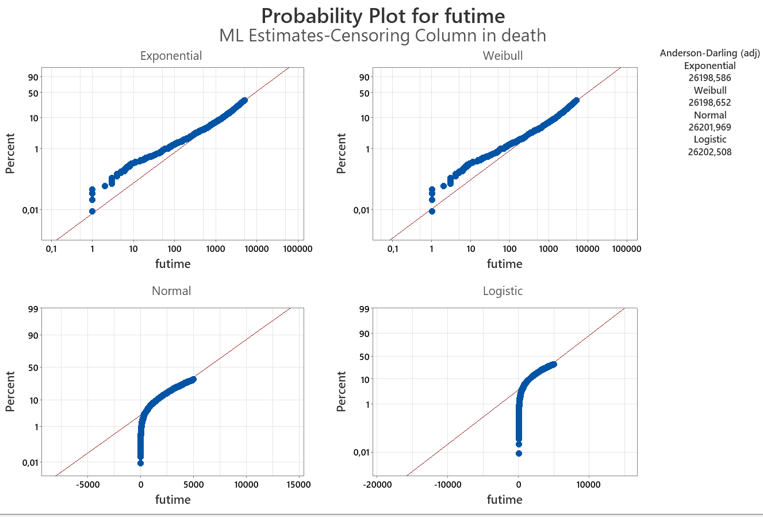
Distribution for the Data
Minitab

Slide 17
MLE Estimation
We will estimate the parameter λ using the Maximum Likelihood Estimation (MLE) method.
To calculate the mean value of the estimated distribution, we use the inverse of the estimated parameter. Thus, we calculate: 1/(7.5112923×10−5)≈13310.41 / (7.5112923 \times 10^{-5}) \approx 13310.41/(7.5112923×10−5)≈13310.4
This represents the estimated mean value of the distribution derived from the MLE method.

Slide 18
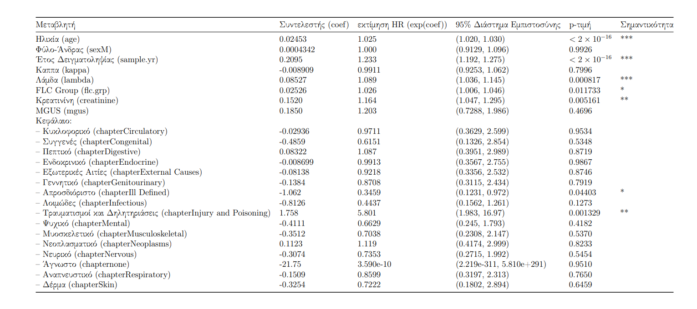
Cox Model
The Cox model, also known as the proportional hazards model, is one of the most popular models for survival analysis in biostatistics and epidemiology. It allows for the estimation of how various factors affect the occurrence of the event of interest, specifically the risk of death.
From the above results, it is observed that statistically significant variables in the studied model are: Age (age), sample year (sample.yr), lambda (lambda), FLC group (flc.grp), creatinine (creatinine), and the variable chapter through the dummy variables: Injury and Poisoning, Ill Defined.

Slide 19
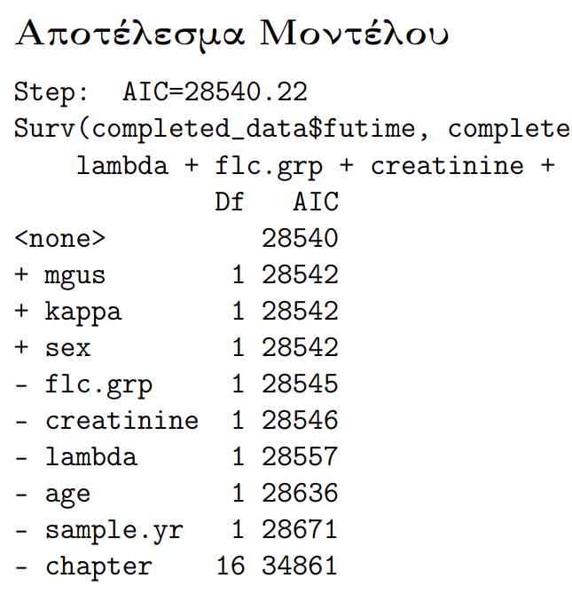
Variable Selection
Techniques such as "Forward Selection," "Backward Elimination," and "Stepwise Selection" are used to find the best fitting model for a dataset.
These variable selection methods all resulted in the same final model, confirming the consistency and reliability of the results.
The model includes the variables: 'age', 'sample.yr', 'lambda', 'flc.grp', 'creatinine', and 'chapter'.

Slide 20
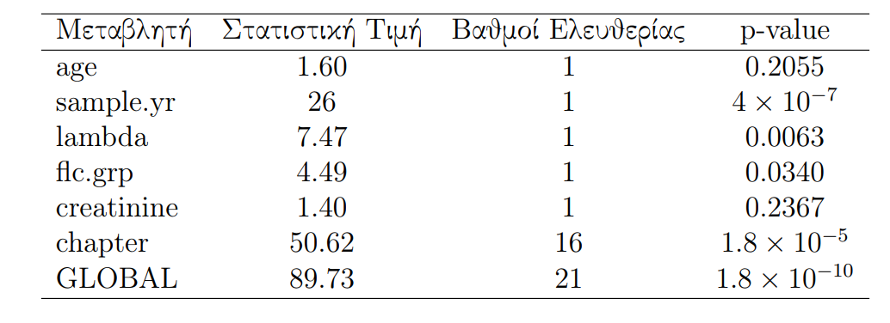
Cox Hypothesis Test
The proportional hazards assumption suggests that the relative risk (hazard) remains constant over time.
The model violates the proportional hazards assumption.

Slide 21
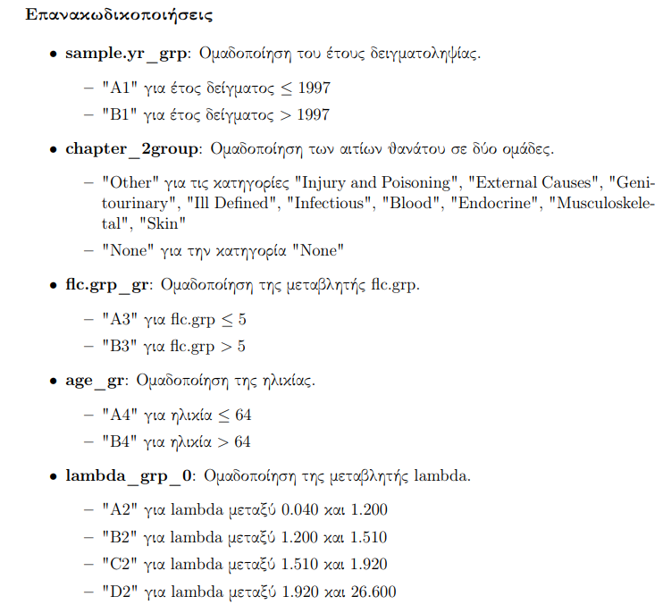
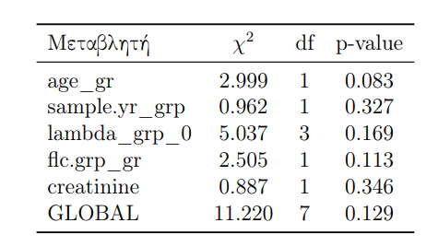
Addressing the Violation of Proportional Hazards Assumption

Slide 22
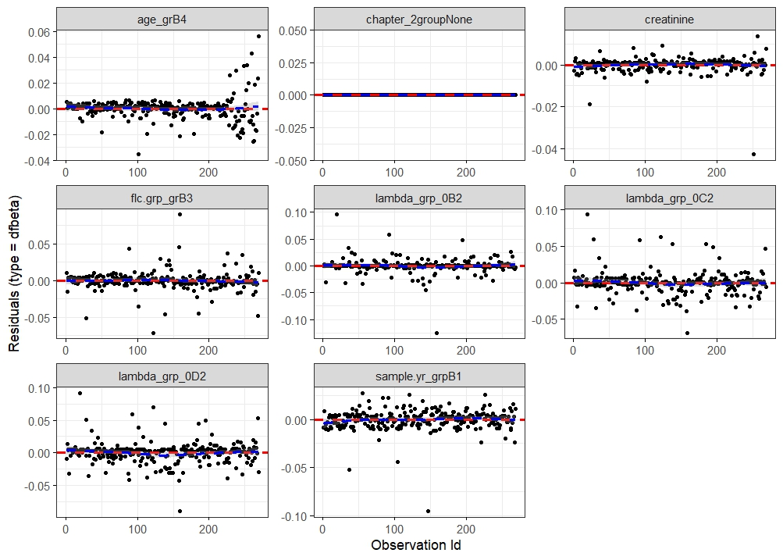
Influence Observations
The DFBETA residuals show the impact of each observation on the parameter estimates of the Cox model.

Slide 23
Analysis of Influence Observations
It is observed:
High Age
Lambda and Kappa values above the average
Follow-up time below the average
High FLC group values
Παρατήρηση | Ηλικία | flc.grp | Kappa | Lambda | Χρόνος Παρακολούθησης | Κατάσταση θανάτου | Αιτία Θανάτου
20 | 94 | 9 | 1.80 | 2.29 | 1903 | 1 | Κυκλοφοριακό
28 | 90 | 6 | 1.48 | 1.53 | 2718 | 1 | κυκλοφοριακό
93 | 96 | 10 | 2.01 | 6.24 | 57 | 1 | κυκλοφοριακό
122 | 86 | 10 | 3.23 | 3.13 | 2344 | 1 | κυκλοφοριακό
147 | 87 | 10 | 2.95 | 9.23 | 398 | 1 | Νεόπλασμα
159 | 82 | 10 | 3.16 | 2.80 | 1881 | 1 | Νεόπλασμα

Slide 24

Thank you for your time.

